Slide 1

Efficient and Scalable Top-K Ranking
Changho Suh
KAIST
Princeton University
Sept. 29, 2015
Joint work with Dr. Yuxin Chen (postdoc in Prof. Emmanuel Candes’s group)
TexPoint fonts used in EMF.
Read the TexPoint manual before you delete this box.: AAAAAAAAAAAAAAAAAAAA
Notes:
Thanks for a kind introduction, Emmanuel.
I have prepared a short movie for this talk. So let get started by watching the movie.

Slide 2

Intro

Slide 3

Ranking
One of the fundamental problems in a wide range of contexts.
Applications: web search, recommendation systems, admissions, sports competitions, voting, etc
Lots of efforts made in developing ranking algorithms.
B
A
D
E
hyperlinks
C
PAGE RANK
Notes:
As you can see from this movie, the problem I am considering in this talk is a ranking problem.
Actually the ranking problem is one of the fundamental problems that comes up in many contexts like web search, recommendation systems, sports competitions, voting, to name a few. So there have been lots of works for developing ranking algorithms. One successful work is the development of Google’s PageRank algorithm.

Slide 4


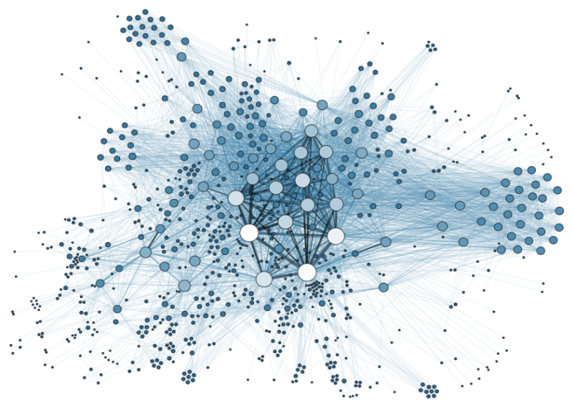
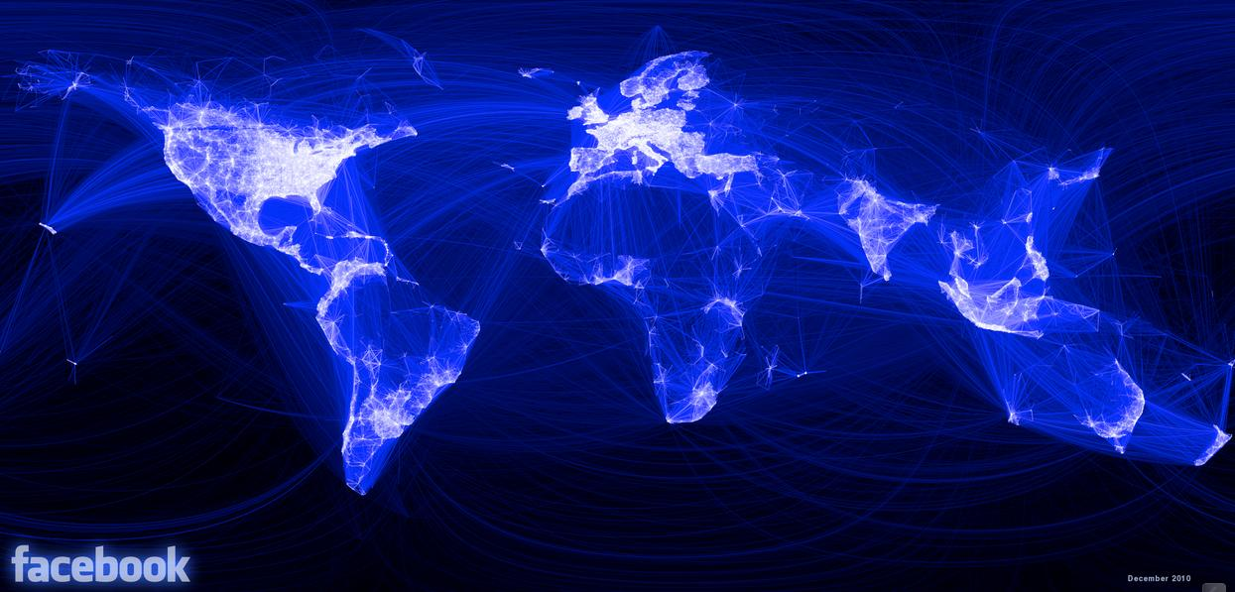
Big data era: A new challenge arises!
80+ billion webpages
1+ billion users
The vast number of items makes the ranking problem computationally challenging!
Hence, current ranking paradigms (e.g., PageRank) often serve only as offline algorithms.
Notes:
However, in the big data age, we are faced with a new challenge. Actually the challenge comes from the fact that in the big data age, the number of items to be ranked is significant big. For example, the number of websites being managed by Google is over 80 billion, and the number of facebook users is over one billion. So the challenge is that the vast number of items makes the ranking problem computationally challenging.
So, in the big data age, current ranking algorithms such as PageRank often only as offline algorithms.
In order to address this challenge, in this work,

Slide 5


Two innovative approaches
1
Focus on identifying only top-K ranked items
Will reduce:
(i) sample complexity
(ii) computation runtime
2
Employ distributed computing framework
Partial synchronization
to the extent that top-K ranking
performance is not crippled.
Notes:
We are taking two innovative approaches.
The first approach is about a performance metric. Actually the existing ranking algorithms have focused on identifying a ranking of the entire items. However, in many realistic applications, we are often interested in identifying only a few significant items, say top-K ranked items. So this motivates us to take a different approach, which is to focus only on a few significant items among many others. Obviously this approach will serve to reduce the number of data samples required for ranking (in other words, sample complexity) and therefore it will improve the computation runtime in the end.
The second approach is about scalability. In an effort to address the scalability challenge, many people have often employed distributed computing framework. However, there is a challenge in applying the current approach. The challenge is that the current approach is not well customized to the distributed computing framework, so it requires frequent information exchanges between different machines. And this incurs a significant communication overhead. To overcome this challenge, we take a new approach, that is, to apply partial synchronization between distributed machines. Actually this idea makes sense because here we focus on identifying only top-K items. As long as we apply partial synchronization to the extent that top-K ranking performance is not crippled, then it would be okay.
Our goal of this work is to take these new approaches,

Slide 6


Our goal
HUGE ITEMS
TOP-K ITEMS
PARTIAL
SAMPLE
TOP-K
RANKING
Taking these approaches, develop an online ranking algorithm
that (1) runs in real-time; (2) achieves high ranking accuracy
Notes:
to develop an online ranking algorithm that returns top-K ranked items almost in real-time with high ranking accuracy.
In order to achieve this goal, we set out three specific sub-goals.

Slide 7
Three sub-goals
3. ENHANCED SCALABLITY
HUGE ITEMS
TOP-K ITEMS
PARTIAL
SAMPLE
TOP-K
RANKING
1. OPTIMAL
SAMPLE COMPLEXITY
2. COMPUTATIONAL
EFFICIENCY
ranking infeasible
ranking feasible
sample size
??
Notes:
The first is about sample complexity. Like Shannon capacity in communication, one can expect that there exits the fundamental limit on the number of data samples, above which top-K ranking is feasible, and under which top-K ranking is infeasible no matter what we do and whatsoever. So the first goal in this work is to characterize this limit, the optimal sample complexity. This characterization will quantify the very least amount of information needed for ranking, and therefore, will help overcoming the computational challenge, induced by huge data sets processing.
The second is to develop a computationally efficient low-complexity algorithm that can achieve the limit.
The last is to implement our algorithm on a distributed computing framework, thereby offering great scalability.
During the past few years, we could achieve these sub-goals.

Slide 8
Main results
A prominent pairwise comparison model:
PAIRWISE SAMPLE
TOP-K
RANKING
TOP-K ITEMS
scores of n items
2
1
4
3
FOCUS OF THIS TALK
1
Characterize minimal sample complexity (up to some constant factor)
ranking infeasible
ranking feasible
sample size
2
Develop a low-complexity algorithm that achieves the limit.
3
Implement on GraphLab, offering enhanced scalability.
Notes:
Specifically we could do this for one prominent benchmark model that has been employed for evaluating the ranking accuracy of algorithms in many applications.
In this model, there are two underlying assumptions. The first assumption is that there exists ground-truth preference scores of items, say n items, and these scores determine a ranking of items. The second assumption is that sample measurements are of the pairwise comparison information type, like movie A is preferred over movie B, or player A defeats player B.
For this model, we could do three things. First we characterized the fundamental limit on the data samples required for top-K ranking, up to some constant factor. Second, we could also develop a computationally-efficient low-complexity algorithm that can achieve the limit. Lastly, we could implement our algorithm on one of the popular distributed computing frameworks, called GraphLab, thereby offering enhanced scalability.
In this talk, I will present only the first and second parts.

Slide 9
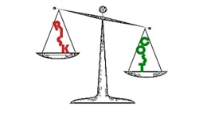

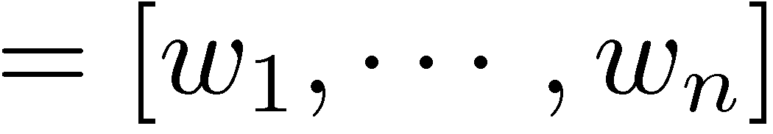
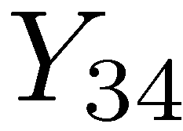
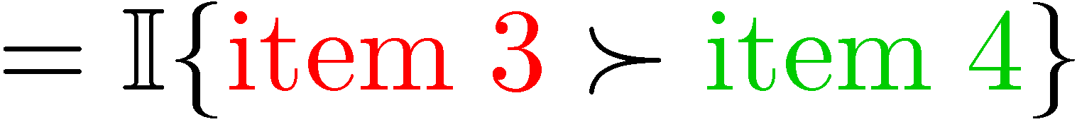
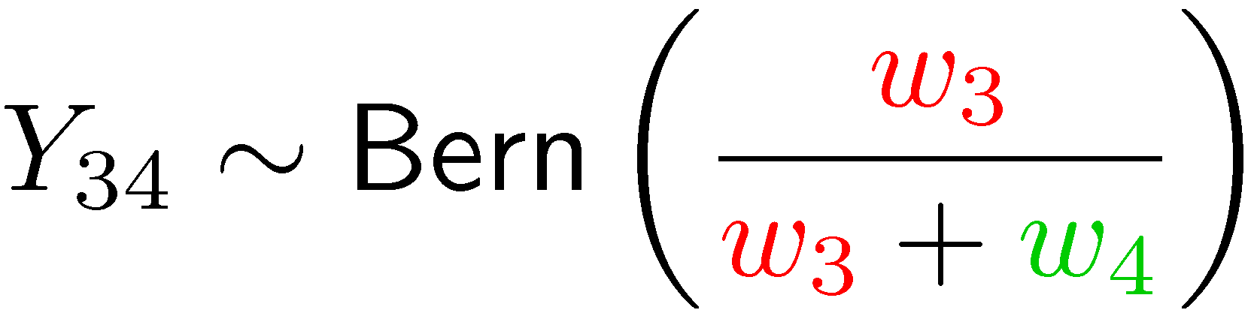
Pairwise comparison model
Bradley-Terry-Luce model `52
comparison graph
2
1
4
3
score vector
Notes:
Let’s start by considering the popular statistical model that we considered in this work.
As I mentioned earlier, there are two underlying assumptions. The first assumption is that there exists ground-truth scores of n items, say w1,w2, all the way up to wn and these scores determine a ranking of items.
The second assumption is that sample measurements are of the pairwise information type. Specifically the information that we are given is pairwise comparison information associated with the scores of two items involved.
But there is a limitation. The limitation is that we are given “only partial pairs” of information. Specifically the set of partial pairs is determined by a so-called comparison graph. In this graph, an edge connection means that we get comparison information for the associated two items. For example, here we have an edge. So we get something, say Y34. In this model, the information that we get is a binary random variable, indicating whether or not item 3 is preferred over item 4. In the model, the probability of this event is determined by the relative scores of the two items involved. So it is a Bernoulli random variable with the following parameter: w3 over w3+w4. This is a kind of making sense.

Slide 10








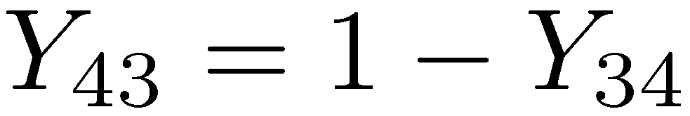
Pairwise comparison model
Bradley-Terry-Luce model `52
comparison graph
1
2
3
4
2
 |  |  | 0
1
1
4
2
0
1
1
3
0
3
1
score vector
4
noisy measurement
Notes:
So it could be for example, zero like this. And here by convention we assume that the other guy Y43 is 1-Y34. Similarly we get Y23 for this pair, and Y12 for this pair.
Now if you think about it, then you can see that these measurements are a kind of noisy measurements because these are random variables, so there are uncertainties.
In an effort to capture the quality of measurements, this model introduces another parameter, denoted by L.

Slide 11
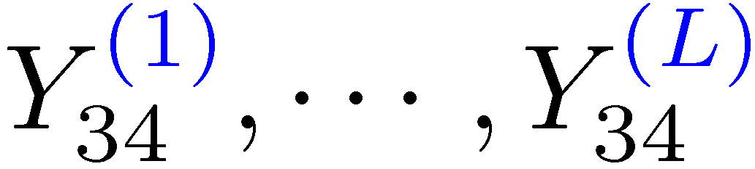
Pairwise comparison model
Bradley-Terry-Luce model `52
1
2
3
4
L=1
0
2
 |  |  | 0
 | 5
5 |  | 8
 | 2 |  | 3
 |  | 7
1
1
4
2
0
1
1
3
0
3
1
score vector
4
L independent copies
- Captures the quality of meas.
Notes:
Here L indicates the number of independent copies for the pairwise measurement. For example, here for Y34, we have L independent copies, say: Y34(1), all the way up to Y34(L). Here we assume that these are i.i.d, each following this Bernoulli distribution.
Now how can we capture the quality of measurement with L? If you think about the sum of all these, then we can see why L captures the quality of measurement. Suppose that for the case of L=10, the sum of these random variables is 3. Then, this number 3 means the total number of wins of item 3 over item 4. Notice that by the law of large numbers, as L goes to infinity, this sum normalized by L will converge to exactly the relative score. So we can see that with larger L, we get more precise information for the relative score of the two items involved. So from this, we can see that L captures the quality of measurement.

Slide 12
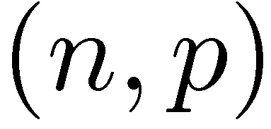
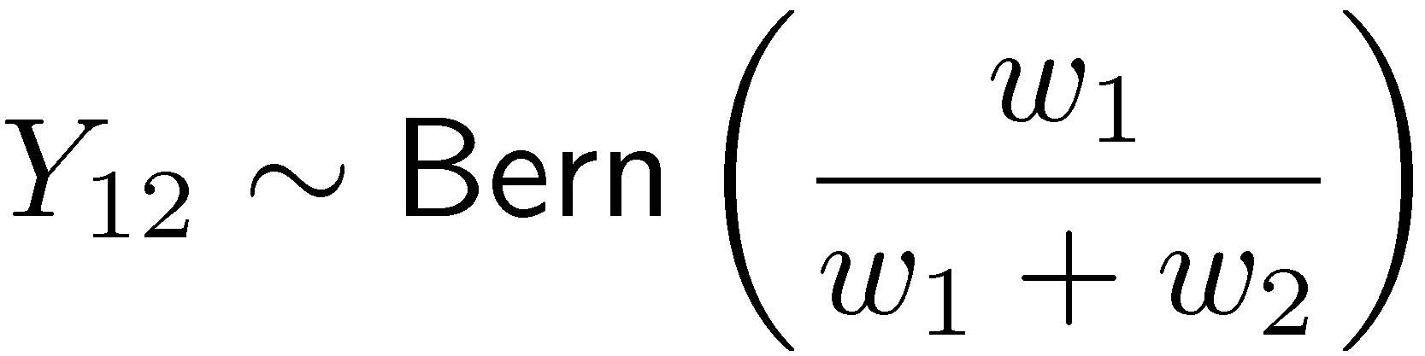
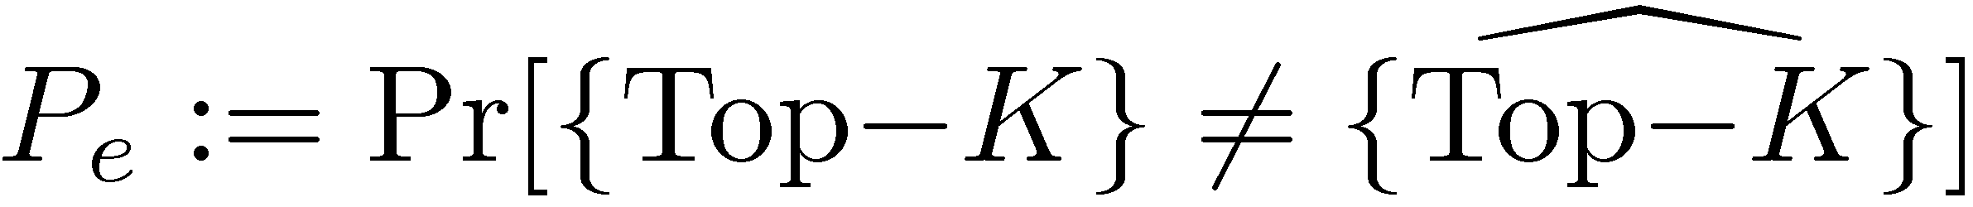
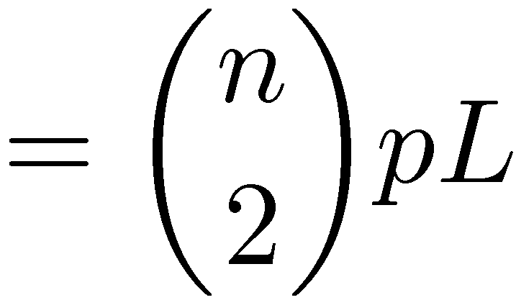
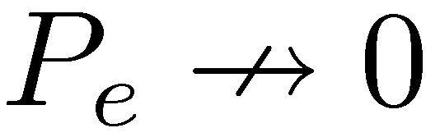
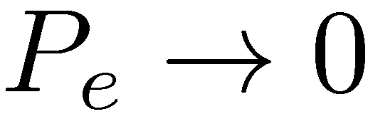
Top-K ranking
Erdos-Renyi graph
TOP-K
RANKING
2
1
4
{Top-K}
3
L indep. copies
ranking infeasible
ranking feasible
sample size
??
Notes:
So these are the information that we can get.
As I mentioned earlier, in this work, we focus on identifying only a few significant items. So the goal of this problem is to characterize the fundamental limits on the sample size required for identifying top-K ranked items.
Specifically, we consider a different performance metric which can directly address the issue. We consider the probability of error, which is defined as the probability that the ground truth top-K set is not the same as the estimated top-K set.
For simplicity, as a comparison graph, we consider Erdos-Reni graph where each pair of any two items is sampled uniformly at random with probability p. p=0 means we observe nothing. p=1 means we observe everything.
So in this model, we have two parameters. L and p. Now the goal is to characterize the fundamental limits on the sample size needed for top-K ranking. Here we say that ranking is feasible if one can make the probability of error arbitrarily close to 0 as n tends to infinity; otherwise, we say that ranking is infeasible. The sample size would be the total number of edges, which is n choose 2, times, edge probability, which is p, times the number of independent copies per pair, which is L. So it is n choose 2 times p times L.

Slide 13
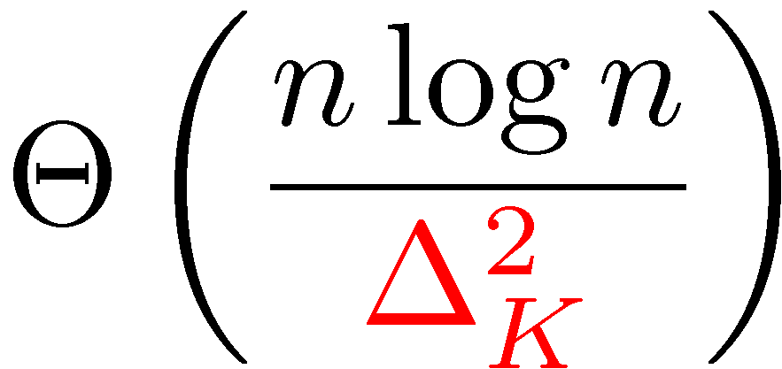
Minimal sample complexity
ranking infeasible
ranking feasible
sample size
normalized score separation btw the Kth and (K+1)th items
Develop a nearly linear-time algorithm.
Notes:
In this work, we characterized the minimal sample complexity for this problem.
It turns out that is the order of n logn divided by Delta_K^2. Here D_K denote a score separation between the Kth item and (K+1)th items, which is a quantity that captures how difficult to separate the boundary items. If you think about it, then this result makes sense, because as Delta_K gets smaller (meaning harder to distinguish the boundary items), we need a larger number of samples for ranking.
As you can see here, we obtained the impossibility result. In this work, we intend to design robust ranking algorithms that protect against the worst case scenario. To do this, we consider a minimax scenario where for any given estimator, the nature is allowed to choose the worst-case score vector that maximizes the probability of error. And under this scenario, we showed that if the sample size is below this limit, then ranking is infeasible no matter what we do and whatsoever.
As I mentioned earlier, we also develop a computationally-efficient low-complexity algorithm that can achieve the limit.
Now for the rest of the talk, I am going to explain how our ranking algorithm works. If time permits, I am going to briefly mention about two more things. One is how to obtain the impossibility result (converse result). The second is how our ranking runs fast.

Slide 14

Ranking algorithm
Top-K ranking
2
ESTIMATE
RETURN
A RANKING
1
4
{Top-K}
3
Scores are consistent with ranking.
→ Take a two-step approach.
Notes:
Here is our ranking algorithm.
Remember that in the pairwise measurement model that we consider, scores determine the ranking. So scores are consistent with ranking. This naturally motivates us to take a two-step approach: first estimate the score vector and then return a ranking based on the estimate. So in this two-step approach, it suffices to develop this first estimation block.
In our scheme, this estimation block consists of two stages.

Slide 15
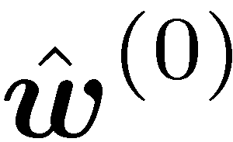

Ranking algorithm
Top-K ranking
STAGE 1
STAGE 2
2
INITIAL. VIA SPECTRAL METHODS
RETURN
A RANKING
1
4
{Top-K}
3
Spectral methods:
PageRank [Brin-Page98], RankCentrality [Negahban-Oh-Shah12]
??
achieve
high ranking accuracy
Notes:
In Stage 1, we first obtain an initial score estimate by using spectral methods like PageRank, RankCentrality, which are popular ranking paradigms.
Actually the spectral methods are shown to be quite good in terms of minimizing the average squared errors between the ground truth and the estimate. And these are shown to provide nearly minimum squared errors. However, notice that in our ranking problem, we are interested in recovering only the ranking, not the scores themselves. So now we have to worry about having the minimum squared error implies high ranking accuracy. It turns out it is not necessarily the case.
Actually we can see why this is not the case by considering the following scenario where for most of items, the score estimates are pretty accurate, while only for a few items, the score estimates are quite different from the ground truth score. In this case, we can have a very small squared loss, but the estimated ranking could be quite different from the ground-truth ranking. So this could be an issue.

Slide 16

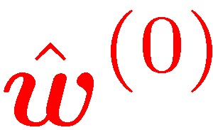
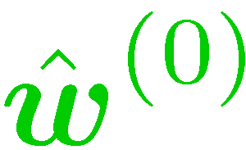
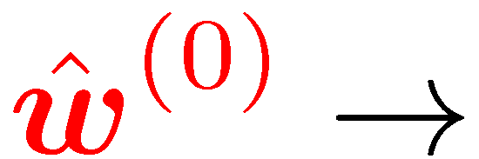
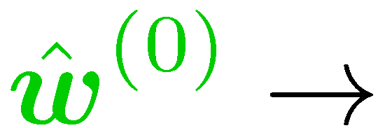

??
high ranking accuracy
ground truth:
score
outliers
estimate:
estimate:
Top-3=
{1,4,9}
Top-3={1,2,3}
Same squared error:
item index
Notes:
Here is a detailed example. Suppose we have the following ground-truth. We have two estimates: red estimate and blue estimate. These are the estimates such that the squared losses are exactly the same. Now let me give you a concrete example where these two estimates will return very different rankings.
Suppose we want to recover Top-3 items. So the K is 3. Then, red estimate returns top-3 as item what? 1, 4, 9, due to these outliers. On the other hand, the green estimates returns the correct top-3 items: 1,2,3.
From this, you can see that having a small squared error does not necessarily imply high rank accuracy. To guarantee high ranking accuracy, we need to detect outliers and then control the point-wise error with respect to the outliers. This motivates us to employ

Slide 17



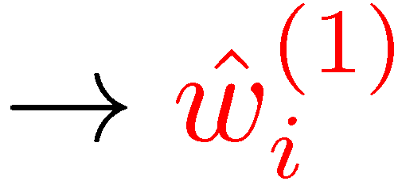

Stage 2: Detect outliers & control point-wise error
ground truth:
score
outliers
estimate:
threshold (carefully chosen)
Idea: Apply point-wise MLE
Repeat the same for all other items.
Then move to next round.
item
Notes:
The second state. So the role of Stage 2 is to detect outliers and then control the point-wise error for the outliers. The idea for this is to apply point-wise MLE. This is how it works. We consider a specific item, say item i. For this item I, we then find the MLE with respect to item i’s score while fixing the other items’ score estimates. We then compute the gap between the previous estimate and the new estimate. If this gap is bigger than some threshold which is carefully chosen under our scheme, then we consider this guy as an outlier. We then control the point-wise by replacing the previous estimate with the new one. Otherwise, we keep the previous one. We apply the same procedure for all of the other items, one-by-one, step-by-step. We then move to the next round.

Slide 18
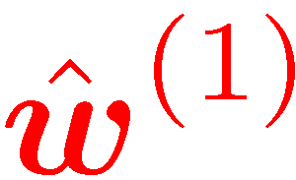
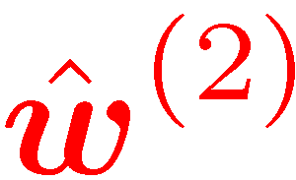
Stage 2: Repeat the same in next round
ground truth:
score
outliers
estimate:
threshold’ (reduced)
Top-3={1,2,3}
item
Notes:
In the next round, we repeat the same procedure. We apply the point-wise MLE for all the items one-by-one to get the following.
It turns out that as long as the sample size is above the fundamental limit that I mentioned before, then with more rounds, we can detect all of the outliers successively and then control the corresponding point-wise errors, thereby guaranteeing the perfect top-K ranking recovery. In this particular example, we could recover the top-3 rank set only with two rounds.

Slide 19
Key features
With a proper initialization, the iterative stage converges rapidly.
Non-convex problem → spectral initialization + iterative refinement
(linear-time complexity)
Inspired by non-convex procedures:
Keshavan-Montanari-Oh (matrix completion)
Jain-Netrapalli-Sangavi (robust PCA)
Candes-Li-Soltanolkotabi (phase retrieval)
Balakrishnan-Wainwright-Yu (EM algorithm)
:
Notes:
There are two distinguishing features of this algorithm.
One key feature of our algorithm is that: once we start with a proper initialization, then we can ensure the iterative estimate to converge to a reasonably good estimate in a very fast manner.
The second feature is that our algorithm has nearly linear-time complexity. Actually our ranking problem is a non-convex problem, which is often intractable. But it turns out we can make the problem tractable, by taking the two-staged approach that combines spectral initialization and iterative refinement. Fortunately, the spectral methods and the point-wise MLE that we are employing are both linear-time algorithms. So our algorithm is also linear-time algorithm.
Actually this idea is inspired by recently developed non-convex procedures that has been applied to many interesting problems like matrix completion, robust PCA, phase retrieval, and EM algorithm. So in that regard, it is not quite new.

Slide 20
High ranking accuracy
Our algorithm achieves minimal sample complexity.
→ Can expect: Given partial samples, it provides the best ranking accuracy.
We confirm this with synthetic data simulations.
Notes:
From this result, we could show that our algorithm provides two promising aspects.
First, high ranking accuracy. Remember that our algorithm achieves minimal sample complexity.
So from this, we can expect that now given partial samples, our algorithm provides the best ranking accuracy.
Actually we could confirm this by doing synthetic data simulation.

Slide 21
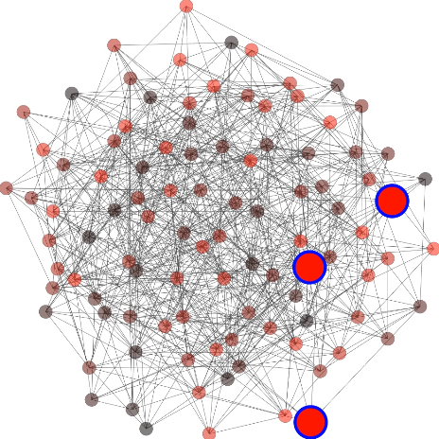
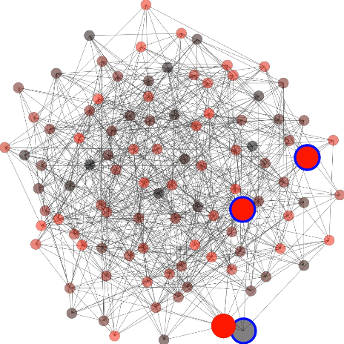
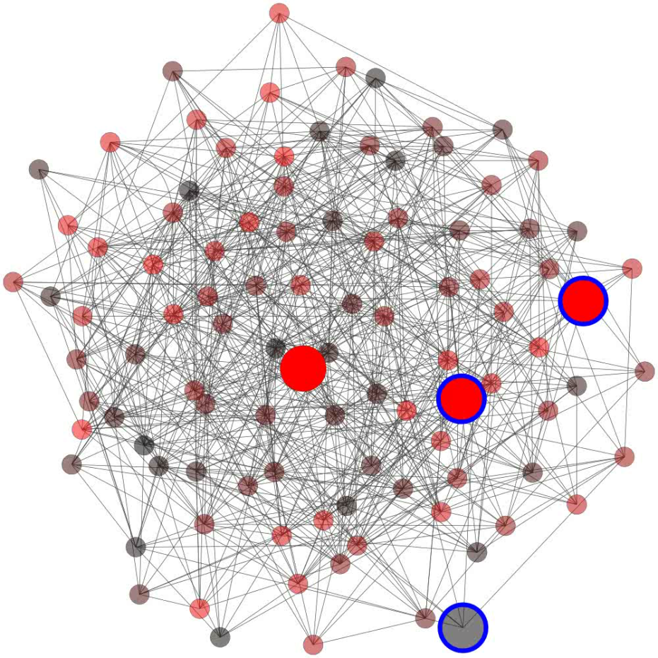
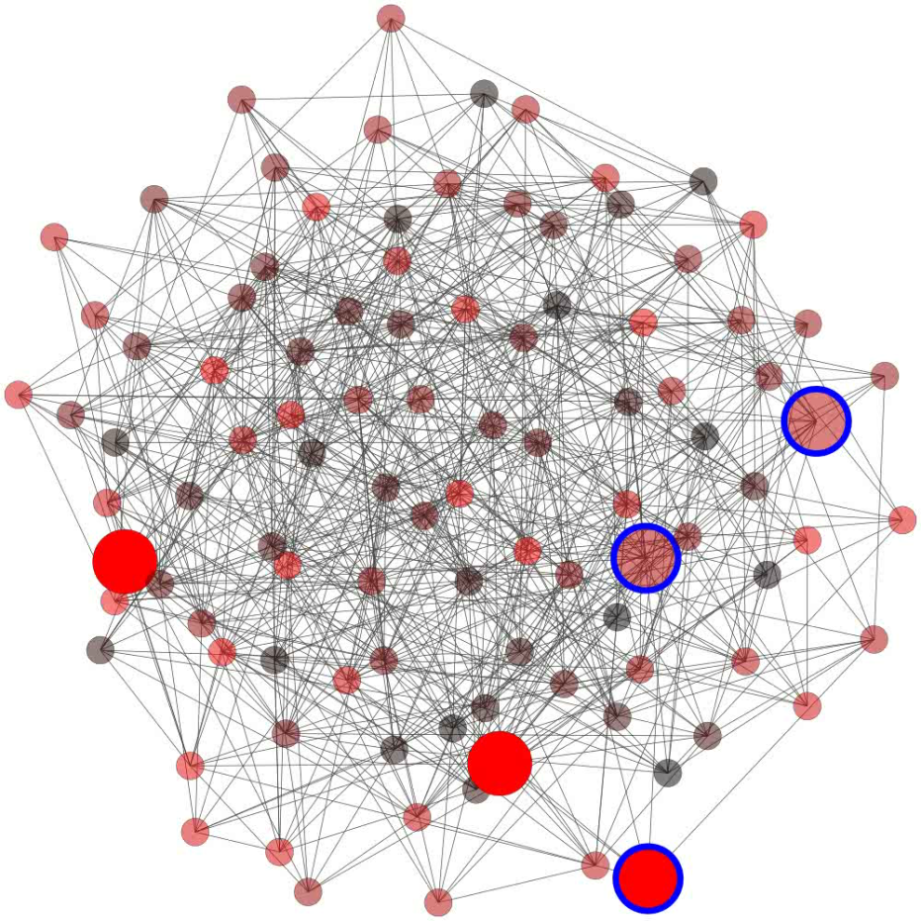
High ranking accuracy
Top-3 identification out of 100 items
Ground-truth
Estimate
PageRank
Proposed algorithm
FAIL
SUCCEED
Notes:
Here we did some simulation for top-3 identification of 100 items, demonstrating that our algorithm provides higher ranking accuracy compared to PageRank.
To visualize the result, I am going to show you a graph. Here in this graph, the vertices indicates items and edges indicate pairwise comparison information for sampled pairs. The blue circles mean the ground truth top-3, and the red circles indicate an estimate. Actually PageRank is an iterative algorithm where for each iteration, a top-3 estimate is updated. Here is a visualization of many iterations. As you can see, score estimate is updated for each iteration. For this realization of the graph, we could see that PageRank fails in ranking. Here you can see that the final estimate is not the same as the ground truth blue circles.
On the other hand, for exactly the same realization of the graph, we could see that our algorithm succeeds in ranking. Here you can see that the final estimate is the same as the ground truth.
Actually for many other realizations, we could observe this phenomenon, so we could show that our algorithm provides higher success rate compared to PageRank.

Slide 22
High ranking accuracy
Top-3 identification out of 1000 items
Our algorithm provides higher empirical success rate.
Notes:
Here is the result. Here we plot the empirical success rate for two algorithms. Here x-axis is D_K, score separation between Kth item and (K+1)th items. As you can see, the proposed algorithm provide higher success rate for the entire range of the score separation.

Slide 23
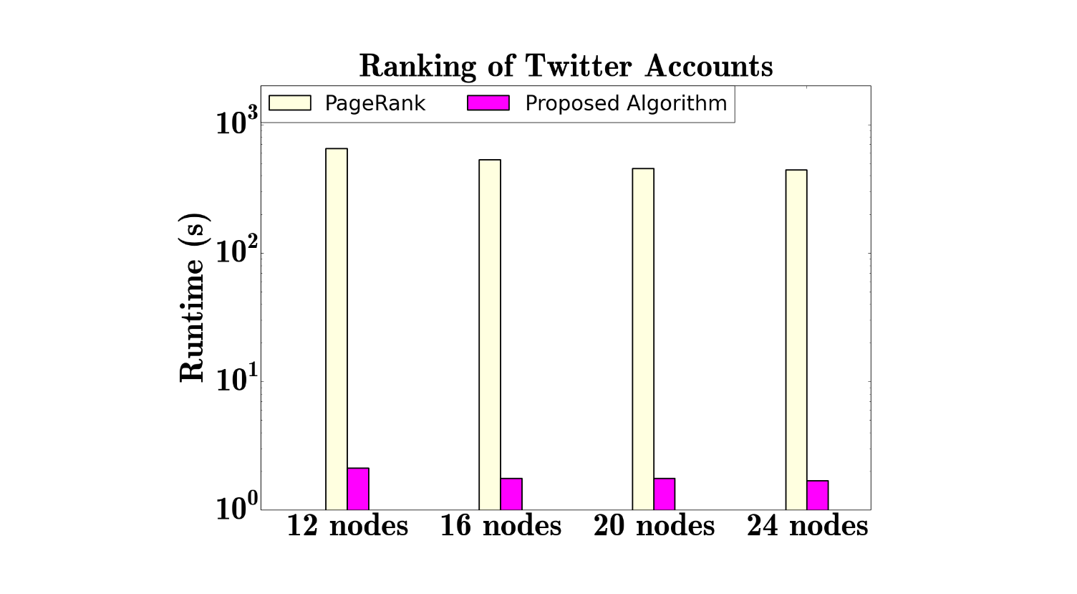
Enhanced scalability
41.6M Twitter accounts
Pairwise info type (A follows B)
Tested on a real data set:
Top-100 ranking
Ranking within a few seconds
Notes:
We could also verify that our algorithm offers great scalability.
We could do this by testing our algorithm on a real data set where three are around forty million Twitter accounts, sample measurements are of the pairwise information type, like A follows B, B follows C, etc. Here we considered top-100 ranking.
Here we plot runtimes for the two algorithms, for four different cases depending on the different number of machines. Here you can see that for all the cases, PageRank runs in a few minutes, on the other hand, our algorithm runs only a few seconds. So we could show that our algorithm provides great scalability.
In summary, we could develop an online ranking algorithm that runs in real time with high ranking accuracy. As mentioned earlier, however, we did this for a popular but particular pairwise comparison model.

Slide 24


Extension
Extend our solutions to a broader class of measurement models.
General model
PARTIAL
SAMPLE
TOP-K
RANKING
ground truth #1
▪ Mixture model postulating the existence of multiple ground truths
ground truth #2
:
▪ List-wise comparison model
triple-wise comp: item 2 item 1 item 3
▪ Value-based model
individual ratings:
Notes:
So our plan is to extend our solutions to a broader class of measurement models.
Specifically we consider three models. In our preliminary work, we considered the case where there is only one ground truth. But in many realistic applications, there may be different user population which has different preferences on items. So the first model would be the one that assumes the existence of multiple ground truths.
The second model is the one where sample measurements may not be limited to the pairwise comparison, so it is a list-wise comparison model. For example, it could be triple-wise comparison, like this: item 2 is preferred over item 1, and item 1 is preferred over item 3.
The third model is the one where sample measurements are not of the preference comparison information, but individual scores, like individual rates of movies.
So our plan is to generalize our solution to more general models.

Slide 25





Impact
Our algorithms will provide
online recommendation services
Aggregation
ITEMS INFO
AGGREGATION
(EX: NEWS)
Filtering
(key enabler)
Top-K ranking
QUERY
REAL-TIME TOP-K RANKING
Broader applications:
Google’s new search engine (Trending topics on Twitter)
TOP-K ITEMS
Caching (Fast contents delivery services)
Notes:
Next: Impact.
We believe that our algorithm will play a crucial role in providing fast online recommendation services. Actually we can easily expect this by looking at the process of this service.
The process consists of three steps. First: aggregation. First we aggregate all the items of interest. Second: Now given a query, we filter the items to product only query-relevant items. But here the problem is that even the filtered items could be huge. So we need another step, which is to identify top-K items. This is where our algorithm kicks in.
Also it will have an impact upon broader applications. Two weeks ago, Google launched a new search engine which include real-time contents like Tweets in its search results. So our algorithm will play a significant role in running this kind of real-time search engine.
Also it can be applicable to content delivery services, because it allows us to identify popular contents that are desired to be cached for fast contents delivery services.
We believe there would be more and more applications.

Slide 26
Conclusion
Explored top-K ranking for a pairwise measurement model.
Characterized minimal sample complexity (up to some constant factor).
Developed an efficient algorithm that achieves the limit.
Implemented on Graphlab, offering enhanced scalability.
Future work: Extension to a broader class of measurement models.
http://arxiv.org/abs/1504.07218
Notes:
Now let me conclude.
In this work, we explore a top-K ranking problem based on pairwise measurements under random sampling.
For this model, we developed a ranking scheme which combines a spectral method and a point-wise MLE. We also showed the minimax optimality of our ranking scheme.
In this work, we consider the case where the comparison graph is Erdos-Renyi random graph and sampling is random. So one future work of interest is to extend to general graphs and adaptive sampling models.
---------------------------------------------
Q1: Any assumption on the preference score?
Q2: How to prove the minimax optimality?
Q3: Any preliminary results on general graphs and observation models?

Slide 27
Backup slides

Slide 28
Minimax optimality
ranking infeasible
ranking feasible
sample size
Proof idea:
Translation to hypothesis testing
Construction of the worst-case score vector
Construction of multiple hypotheses
Tools: KL divergence, Generalized Fano’s inequality, Reverse Pinsker inequality
Notes:
Q. What is the key idea for the minimax optimality result?
Thanks for your great question. In this talk, I entirely removed the converse proof due to time limitation. Here is the sketch of the converse proof. The basic idea is to translate the ranking problem into multiple hypothesis testing problems, and then to construct the worst-case score vector that maximizes the probability error, and then to construct multiple hypotheses that are minimally separated. Here we have to be very careful in choosing the worst-case score vector and the corresponding multiple hypotheses, to obtain a tight result. Once this choice is carefully made, then we can use generalized Fano’s inequality and some properties of KL divergence to prove the converse.

Slide 29

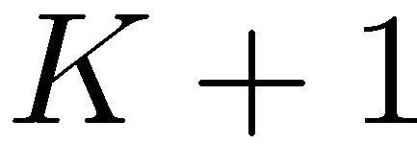
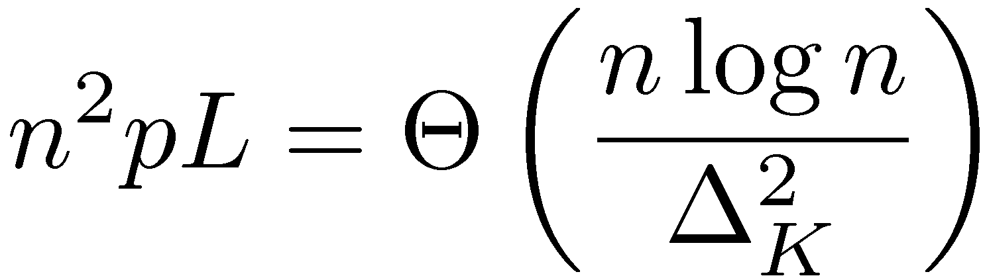
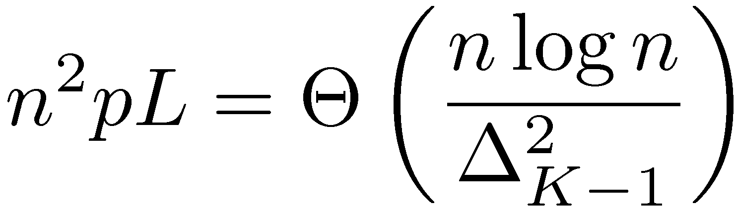

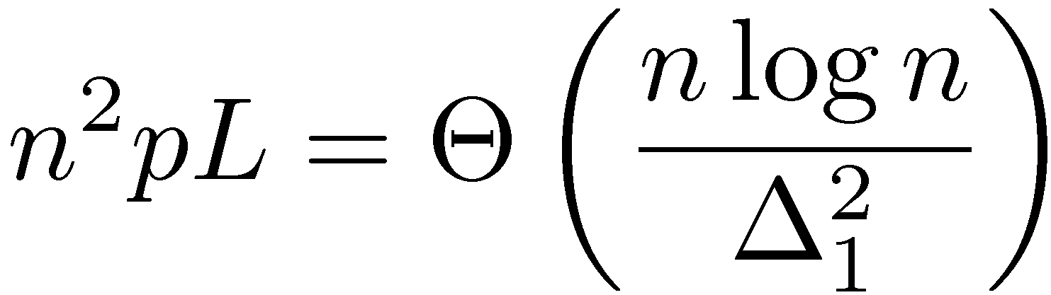
Extension
Detailed ranking among the top-K items
Notes:
Extension. So far we have considered the case where we want to recover only the set of top-K ranked items.
One natural question is: What if we want the detailed ranking across the top-K items.
If you think about it, then you can see that we can easily come up with the minimal sample complexity result in this case. To identify detailed ranking among top-K items, what do we have to do? We first identify the top-K item set, and then identify the top-K-1 item set, and then top-K-2 item set, all the down to top item, right? Then, now you can easily come up with the minimal sample complexity. What was the minimal sample complexity for the case of identifying the top-K item set? That was this. Now the mina

Slide 30
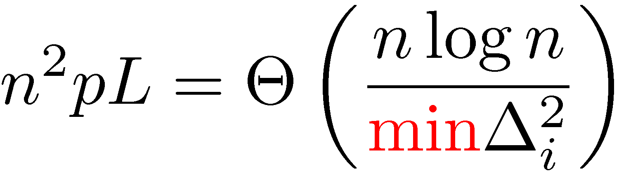
Extension
Detailed ranking among the top-K items
Can easily extend to any-K ranking.
Notes:
The identifiability region we present depend only on the preference separation between items K and K+1, irrespective of other preference distribution metrics. This arises since we only intend to coarsely identify the group of top-K items without specifying the detailed ranking within this group. In fact, our results immediately uncover the separation requirements for the case where we wish to further expect detailed ranking among these K items.
Sample complexity btw two cases will differ significantly when the scores are fairly distinct each other. So exploring the active ranking sample complexity for the case will be of great interest.

Slide 31
Related work
Value-based model
Preference-based model
[Busa-Fekete et.al.’13]:
[Eriksson’13]: Top-K selection scheme with adaptive sampling
[Gabillon et.al.`11] [Bubeck et.al.`13]:
Best-K identification complexity characterized under adaptive sampling
Different settings:
[Alion ‘12]
[Bravernman-Mossel’08]
[Ammar-Shah’12]
[Duchi-Mackey-Jordan’10]
[Soufiani-Chen-Parkes-Xia`13]
[Rajkumar-Agarwal’14]
:
Notes:
Q: Any connection to the multi-armed bandit problem?
A: Indeed there is connection to the top-K ranking problem, but under a different model, not the BTL model that we considered herein. Actually the BTL model is one of the preference-based model where the observation is a kind of comparison information between multiple items. But there is another big family of observation model where the observation is drawn only from the distribution that is associated with a specific item. This model is so called a value-vased model. It turns out that the top-K ranking problem under the value-based model and adaptive sampling can be translated to the multi-armed bandit problem, and also the minimal sample complexity has already been characterized.
Q: Any other work on top-K ranking problem?
A: The most relevant work is the one by Busa-Fekete et.al. They also considered the top-K selection problem. But there are two distinctions. One is that they considered adaptive sampling case. The other is that they considered a different model, not the BTL model.
Q: Any other work on a general ranking problem?
A: Actually there are tons of works. So I cannot enumerate all of them. Those are different since they consider different settings, depending on the goal of the problem, performance metric, model, adaptive sampling vs. random sampling, the observation quality etc. etc. etc. In our work, we focus on one of the prominent popular model, that is the BTL model.

